Slide 1

PokerGame
Team 3
So Mi Choi, Bo Heon Jeong, Hanchen Li,
Sang Rhee, Yixin Wang, Yuying Wang
https://github.com/srhee91/PokerGame

Slide 2
Problem Motivation
Most of today’s poker games are web-based.
Requires internet connection
Requires account registration
Games played with total strangers

Slide 3
Project Goals
A LAN-based, non-web based Hold’em game.
Up to 8 players.
Can quickly jump in or out of games.
Clean and simple interface
2D graphics for cards and chips
Basic animations and sounds
Intuitive onscreen controls.

Slide 4
Project Goals
Performance
Reliability
Usability

Slide 5
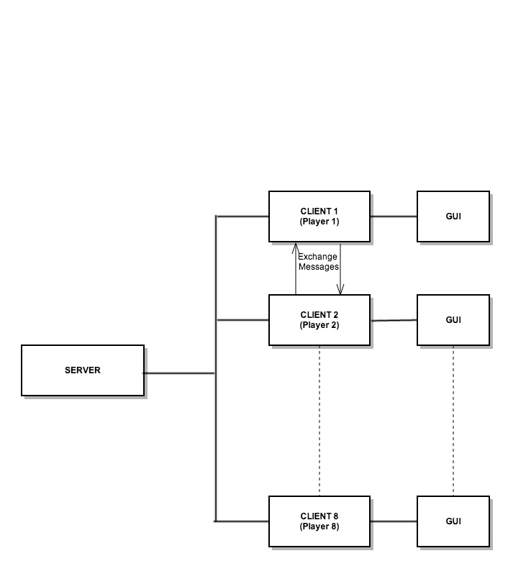
Client-Server Model

Slide 6
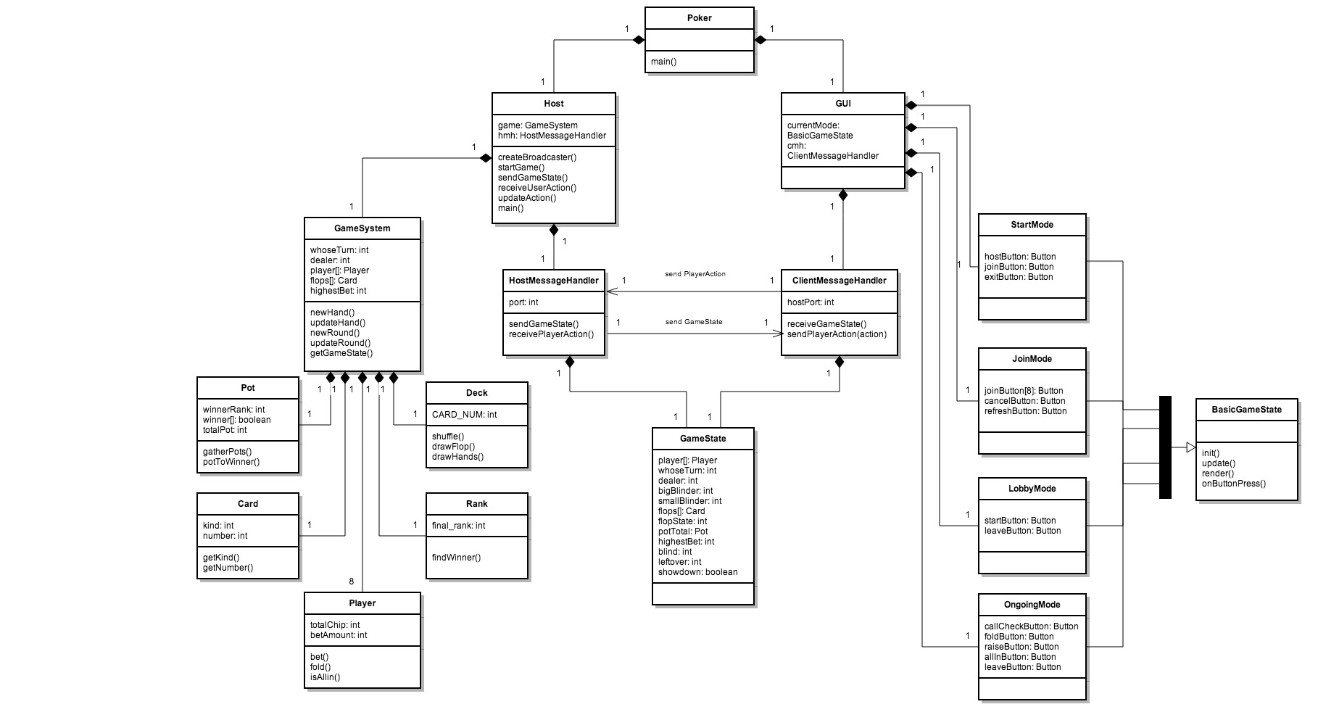

Slide 7
DEMO

Slide 9
Sprint 3 – Description of tasks (1/4)
1. Integrate the animations to correctly respond to received GameState from the host to show each player’s actions. (User Story 1)

Slide 10
Sprint 3 – Description of tasks (2/4)
6. Debug the Rank class through adding test cases that handle all possibilities of poker-hands in the TestRank class. (User Story 4)

Slide 11
Sprint 3 – Description of tasks (3/4)
7. Debug the GUI portion of the game by play-testing the game with all possible user inputs. (User Story 4)

Slide 12
Sprint 3 – Description of tasks (4/4)
6. Debug the GameSystem portion of the game by play-testing the game with all possible user inputs. (User Story 4)

Slide 13
Thank you!

